Slide 1



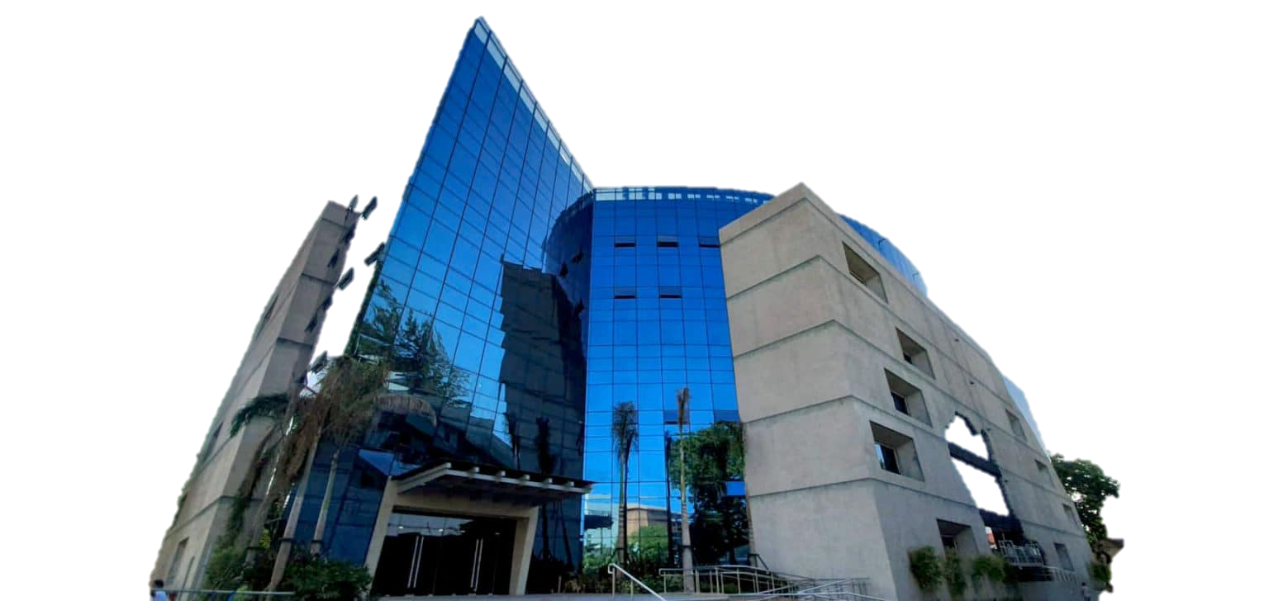
BIRTHDAY KO, HANDOG NAMIN SA IYO
PROVINCIAL GOVERNMENT OF BATAAN

Slide 2

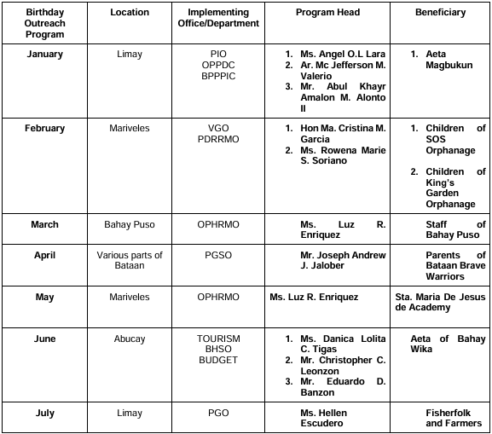
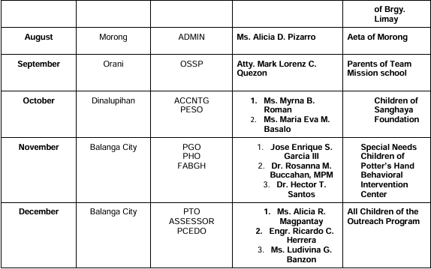

INFORMATION TABLE

Slide 3
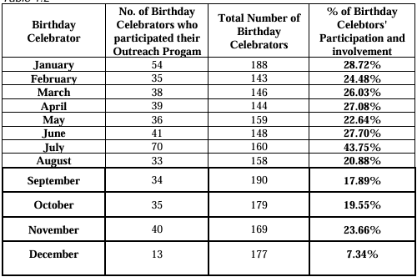
PARTICIPATION RATE
OVERALL AVERAGE EMPLOYEE PARTICIPATION RATE:
24.14%

